Slide 1
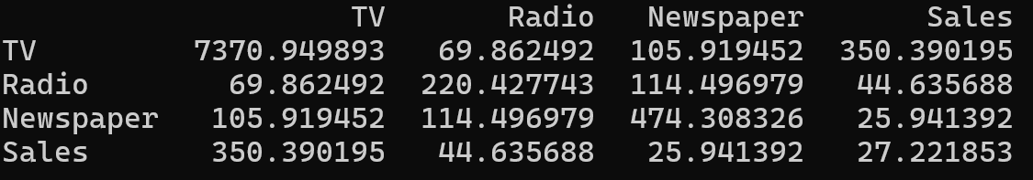
Interpreting Covariance Matrix
Consider the following covariance matrix
Diagonals: Variance of the field, e.g. TV’s variance: 7370, Radio’s variance 220, etc
Rest is covariance, e.g. covariance between TV and radio is 69, etc
Positive covariance: Both are increasing/decreasing simultaneously
Higher the value, higher is the change in one with respect to the other
Example: Higher spend on TV ads -> Higher sales, as compared to others

Slide 2
Descriptive versus Predictive Modelling versus Prescriptive Modelling
Descriptive modelling/statistics: Summarize and describe data
Examples: Mean, Mode, Median, Standard deviation, Range, Frequency distribution
Predictive modelling/statistics: Use data to make future predictions
Examples: Linear/logistic regression, Time series analysis, Decision trees, Machine learning algorithms
Prescriptive modelling/statistics: Use data and models to make most optimum decisions and recommendations
Examples: Linear programming, Decision trees, Game theory

Slide 3
Predictive Modelling

Slide 4
Predictive Modelling
Predictive modeling uses statistics and modeling techniques to make predictions about future outcomes
Looks at current and historical data patterns to see if the patterns are likely to emerge again
Generally classified into regression and classification (See next slide)
Common types: Linear regression, Logistic regression, Decision trees, Random forest, Neural networks, Time series forecasting, K Nearest Neighbors (KNN), Naïve Bayes, Clustering

Slide 5
Regression and Classification
Regression has a numeric target
Classification has a class target
Regression examples | Classification examples
How many page views will we get? | Is this a fraudulent transaction?
What will be the amount of loss? | Whose face is in this picture?
What will be the blood sugar level? | Which product is best fit for the customer?

Slide 6
Regression Analysis

Slide 7
Regression
Regression: Predict a dependent variable using independent variable(s)
Y: Dependent numeric variable, also called predicted/output/target variable
X: Independent variable(s), also called predictor/feature/explanatory/covariate
Given X, we want to find Y
Generally, Y is numeric
When Y is True/False type, it is logistic regression (See next slide)

Slide 8
Main Types of Regression
Linear Regression: Used when the relationship between the independent variable and the dependent variable is assumed to be linear (goal is to fit a straight line to the data)
Multiple Linear Regression: Extends linear regression to include more than one independent variable (i.e. multiple predictors that may influence the dependent variable) – Also called multivariate analysis
Logistic Regression: Used for binary classification problems (e.g., yes/no, 1/0)

Slide 9
Examples of Regression
Linear Regression: Predicting House Prices
Independent Variable: Area of the House (Continuous)
Dependent Variable: House Price (Continuous)
Multiple Regression: Predicting Salary Based on Experience and Education
Independent Variables: Years of Experience (Continuous), Level of Education (Categorical: Bachelor's, Master's, PhD)
Dependent Variable: Salary (Continuous)
Logistic Regression: Predicting Customer Churn
Independent Variables: Customer Tenure (Continuous), Monthly Subscription Cost (Continuous), Customer Complaints (Count)
Dependent Variable: Churn (Binary: Yes or No)

Slide 10
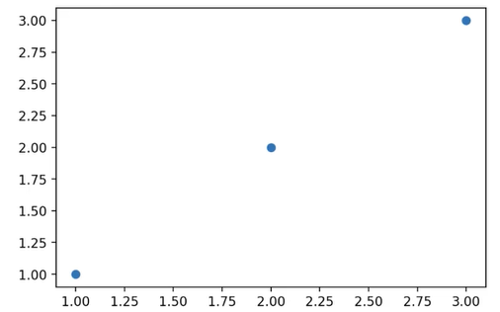
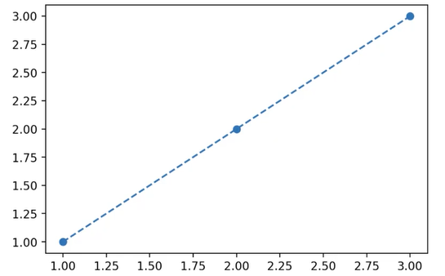
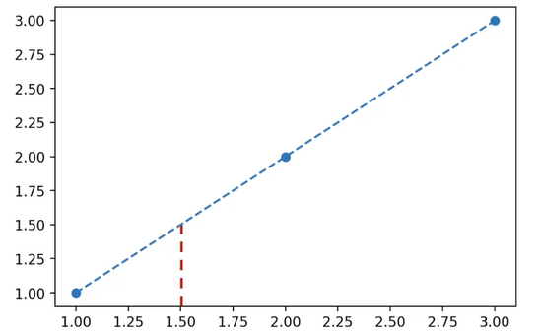
Linear Regression
Implies some constant straight line relationship
Simplest possibility: y = x
We can then draw a line that fits the three data points
Advantage?
For some new x, we can predict y

Slide 11
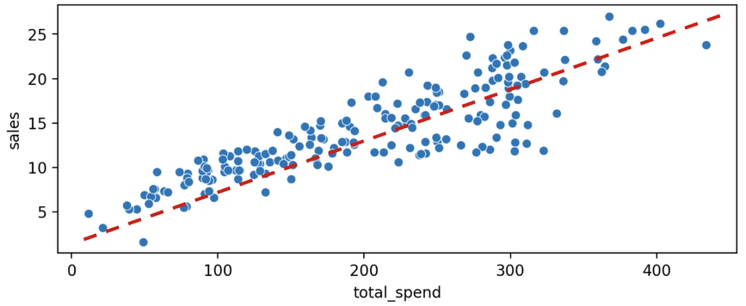
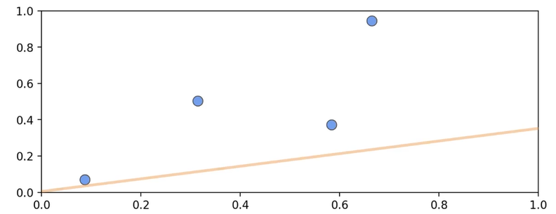
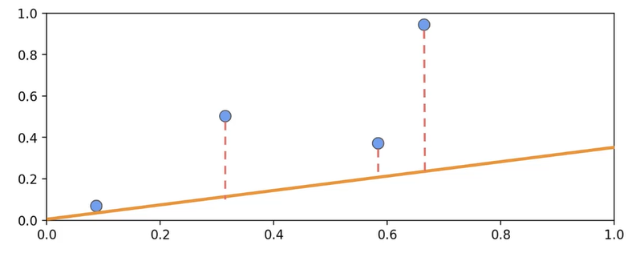
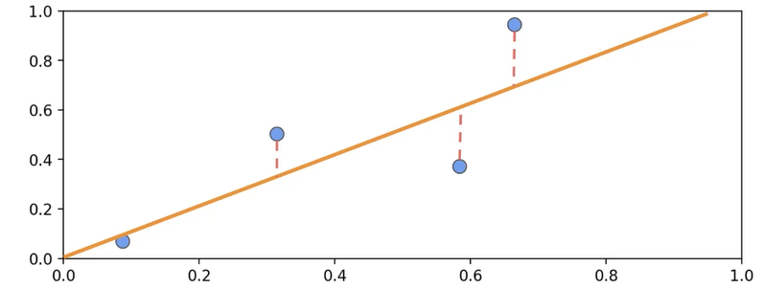
Linear Regression: Real World
In the real world, where do we draw the line?
We want to minimize the residual error
Residual error: Distance between the points and the line
Residuals can be positive or negative

Slide 12
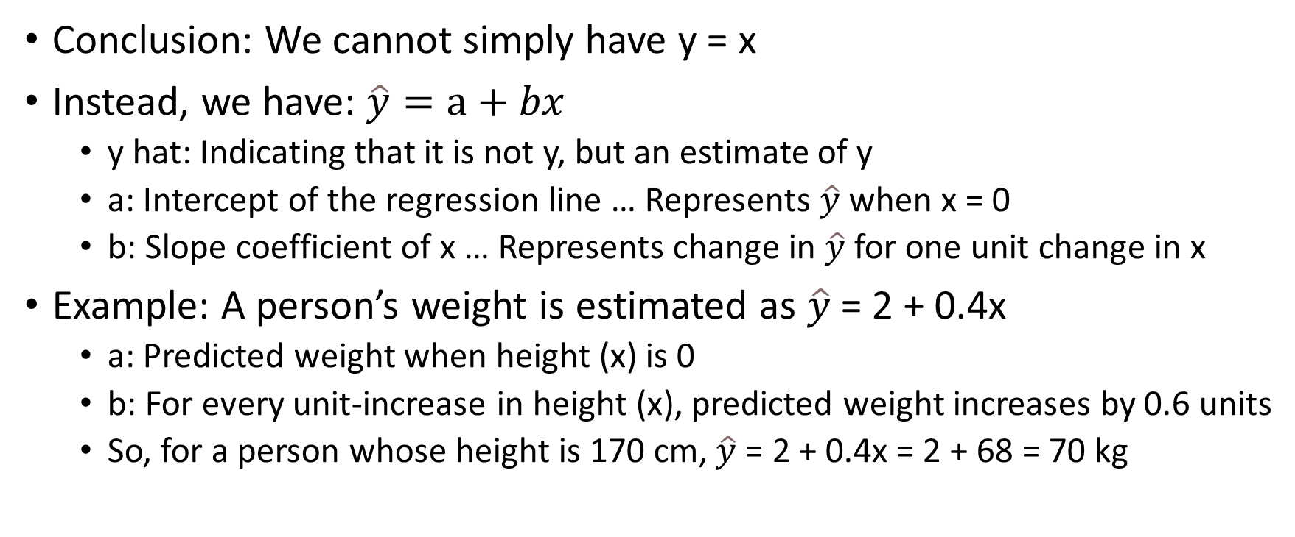
Linear Regression: Real World
Conclusion: We cannot simply have y = x
Instead, we have: $\hat{y}=a+bx$
y hat: Indicating that it is not y, but an estimate of y
a: Intercept of the regression line … Represents $\hat{y}$when x = 0
b: Slope coefficient of x … Represents change in $\hat{y}$for one unit change in x
Example: A person’s weight is estimated as $\hat{y}$= 2 + 0.4x
a: Predicted weight when height (x) is 0
b: For every unit-increase in height (x), predicted weight increases by 0.6 units
So, for a person whose height is 170 cm, $\hat{y}$= 2 + 0.4x = 2 + 68 = 70 kg

Slide 13
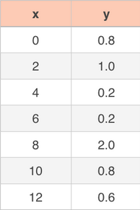
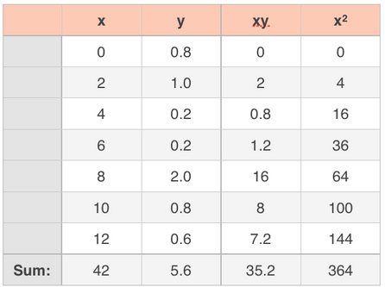
Example
Find least-squares line for this dataset:
First calculate this:

Slide 14
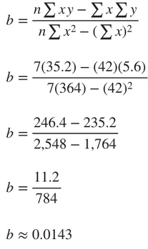
Example
Slope

Slide 15
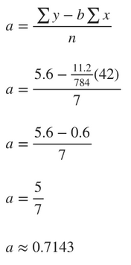
Example
Y-intercept

Slide 16
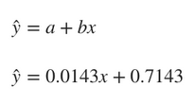
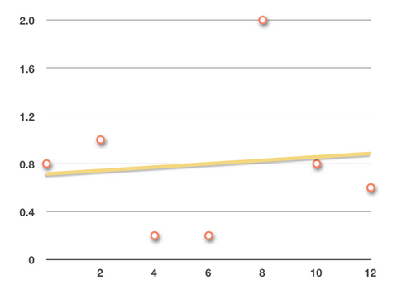
Example
Regression line equation
Regression line

Slide 17
Ordinary Least Squares (OLS)
Ordinary Least Squares: Find the minimum sum of squares of the differences between the observed actual dependent variable values and those predicted by the linear regression model
We find the line (discussed earlier) that minimizes errors (discussed later)
Called line of best fit

Slide 18
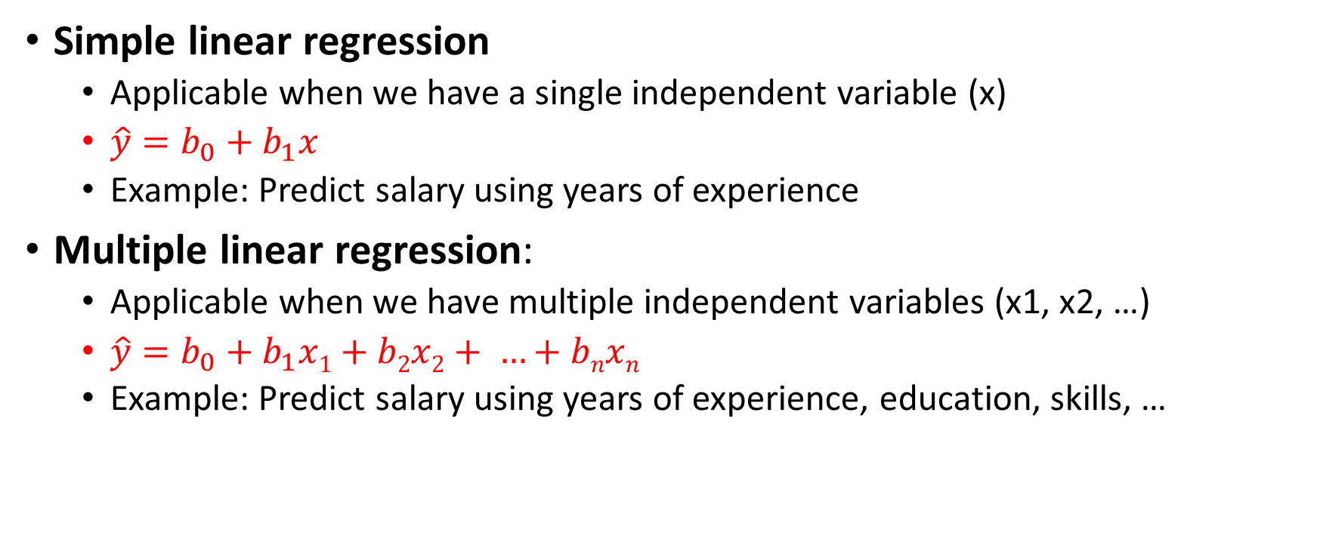
Simple and Multiple Linear Regression
Simple linear regression
Applicable when we have a single independent variable (x)
$\hat{y}=b_{0}+b_{1}x$
Example: Predict salary using years of experience
Multiple linear regression:
Applicable when we have multiple independent variables (x1, x2, …)
$\hat{y}=b_{0}+b_{1}x1+b2x2+ …+bnxn$
Example: Predict salary using years of experience, education, skills, …

Slide 19
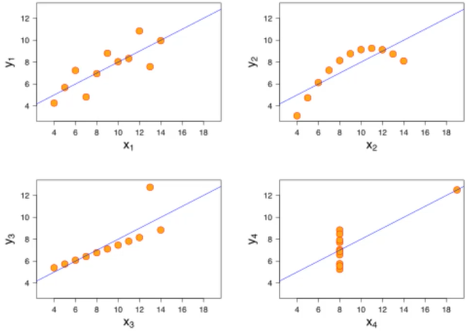
Anscombe’s Quartet
Francis Anscombe: Experiment in which four datasets each containing 11 (x, y) pairs have very similar statistical properties such as mean, SD, linear regression line
When plotted, they look very different
Conclusion: Do not rely on summary statistics/linear regression alone, also visualize

Slide 20
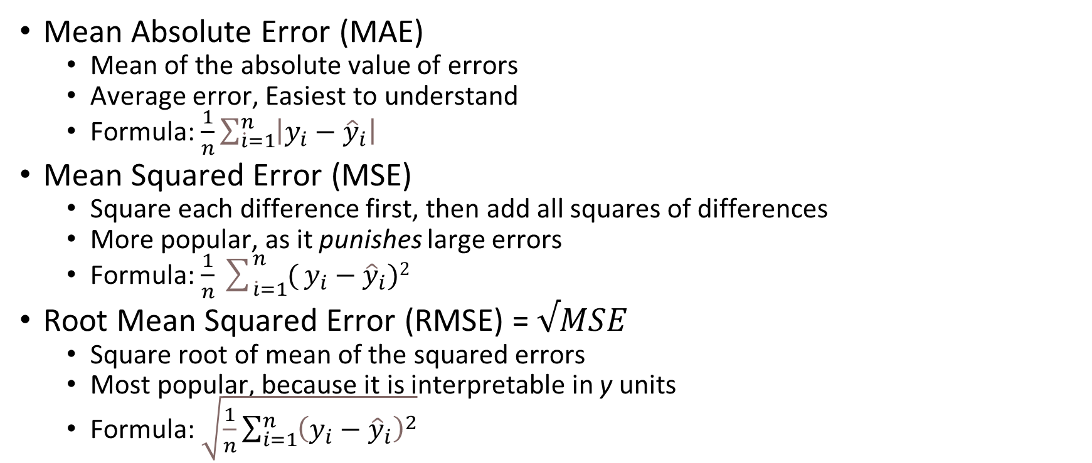
Evaluation Metrics for Regression
All these are called Loss functions, because we want to minimize them
Mean Absolute Error (MAE)
Mean of the absolute value of errors
Average error, Easiest to understand
Formula: $\frac{1}{n}\sum_{\dot{i}=1}^{n}{\left|y_{i}−{\hat{y}}_{i}\right|}$
Mean Squared Error (MSE)
Square each difference first, then add all squares of differences
More popular, as it punishes large errors
Formula: $\frac{1}{n}\sum_{\dot{i}=1}^{n}{(}y_{i}−{\hat{y}}_{i})2$
Root Mean Squared Error (RMSE) = $√MSE$
Square root of mean of the squared errors
Most popular, because it is interpretable in y units
Formula: $\sqrt{\frac{1}{n}\sum_{i=1}^{n}{{\left(y_{i}−{\hat{y}}_{i}\right)}^{2}}}$
What are good/bad values for these? It depends on the data
Example 1: Estimating house prices in the US … Here, RMSE of $10,000 is quite ok in relation to the house prices of $5,00,000-$ 1 million
Example 2: Estimating temperatures … Here, RMSE of 1°C will be considered very high if temperatures normally do not vary greatly

